Slide 1
Achieving Common Goals together – Organizing our Society
The ‘Caste System’

Slide 2
‘Caste’ System
‘CASTE’ is a misleading term that collapses 4 Hindu institutions:
Varna (Four Social Classes) = permanent, scripture sanctioned, pan-Hindu, trans-national. Covers all Hindus except ascetics, tribals, ‘untouchables (‘Avarna, or Panchama =Fifth Varna’), and Hindus who do not follow it.
Jaati (> 3000 castes) = hereditary, endogamous, regional communities or occupational guilds, last over a few decades to centuries, typically mapped to one of the four varnas. All Hindus except Ascetics belong to a Jaati. Recognized but not mandated by scriptures.
Kula (Family Lineage) = cluster of families with blood ties, their unique family customs and traditions, typically exogamous, regional, can last from a few decades to centuries, recognized but not mandated by scriptures.
Gotra/Pravara: Lineage from Rishis and Acharyas (spiritual lineage)

Slide 3
Points to note on ‘Caste’
Hindu Shastras recognize other systems but focus on Varna.
Members of the same Varna can belong to different Jatis. Members of the same Jatis can belong to different Varnas (e.g. Dogra Kshatriyas and Dogra Brahmanas; Modha Vaishyas and Modha Brahmanas).
The terms ‘Jati’, ‘Kula’, ‘Varna’ or even ‘Gotra’ are sometimes confused or used interchangeably.
Some people even use their ‘Sampradaya’ as their ‘caste’, e.g. Dadupanthis.
‘Caste’ is found among practically all residents of Indian subcontinent, including Sikhs, Jains, Buddhists and often also Muslims and Christians. Or it is reflected in their names even after conversion (e.g. Burhan Vani was a Baniya, Maqbool Butt was a ‘Bhatt’ or Brahmana).
Within Dharmic traditions, people will often marry across ‘religions’ but not their ‘caste’. E.g. Khatri Hindu-Sikh.

Slide 4
Varna and Jati
Courtesy: Hindu American Foundation

Slide 5
Jati
Hereditary, typically endogamous groups, over 3000 (estimated).
According to Dharmashastras lists, Jati arises from a mixture of Varnas. When examined, the lists indicate that the group got their ‘vritti’ (profession) from father, and their general lifestyle and behavior (‘vaartaa’) from Mother. E.g. Yavanas resulted from ‘Kshatriya fathers marrying Shudra mothers.’
List of Jatis keeps growing with newer shastras.
In reality, Jatis are communities that gradually became a part of the Hindu society.
Tribals became a part of the Hindu community peacefully through the Jaati system.

Slide 6
Gotra and Pravara
Gotra is lineage from one’s father’s family (patrilineal). All Gotras are said to originate from the Saptarshis (seven or more Rishis).
Wife gets the gotra of the husband after her marriage.
Same gotra (‘sagotra’) marriages are prohibited. Ensures mixing of family lineages.
If the Gotra is not known, default gotras like ‘Kashyapa’ and ‘Bhaarata’ are assigned. Or that of their Purohit is assigned.
‘Pravara’ is a list of distinguished Rishis (seven or less) within the same Gotra.
Most Hindus do not know their Pravara or even Gotra.

Slide 7
The Four Social Classes (Varnas) & Classless Hindus
Brahmins: Sacerdotal, religious, ritual, teaching, judiciary, intellectual functions.
Kshatriyas: Military, Administrative, Legislative functions.
Vaishyas: Agriculture, trade and commerce, cattle rearing, other economic wealth producing functions.
Shudras: Service, labor, artisans, musicians, entertainers
Untouchables: Not sanctioned by scriptures, later development, opposed by Hindu leaders, performed scavenging and cleaning functions. Untouchability is virtually extinct in India today.
Tribals: Have a different social organization with priests, tribal chiefs and the rest.
Ascetics: Considered beyond all social divisions and categories. The pinnacle of Hindu society.

Slide 8
Is the ‘Caste System’ Heirarchical?
The Diagram on the right is misleading! (even numerically)
Superiority of Brahmins is restricted to religious roles.
Kshatriyas are leaders in political and military roles.
Vaishyas lead in wealth.
Shudra in service, entertainment sectors.
In many parts of India, Brahmins are the poorest.
Privileges come with disabilities
Keeps checks and balances in the society (social stability).
Notes:
Typical diagram shown in textbooks. The diagram is misleading and innaccurate.

Slide 9
Varna Dharma in Tamil Nadu

Slide 10
Varna System: Division of Powers
 | Political Power | Business Power | Land Power | Moral Power
Kshatriya | High | Low | Low | Low
Vaishya | Low | High | Med | Low
Shudra | Low | Med | High | Low
Brahmana | Low | Low | Low | High
All jaatis have these classifications either explicitly or implicitly
Separation of powers is important
Varna is about Guna – tendency towards sattvic practice
Moral power comes through tyaaga and knowledge – not by ownership
Brahmanas should be held to higher standards and should
earn their living by begging and being dependent on others

Slide 11
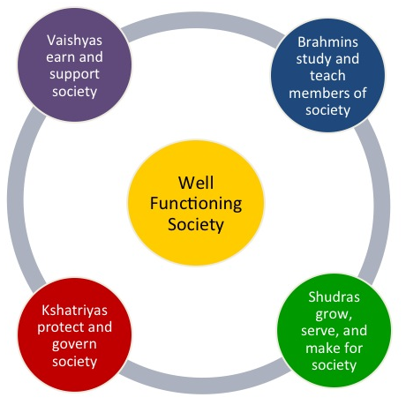
Real ‘Caste Pyramid’
Courtesy: Hindu American Foundation
The Four Varnas were created so that all Human Beings can flourish. In reality, everyone is descendant from Brahmā and originated as Brahmaas.

Slide 12
Questions on the ‘Caste’ System
What is the caste system?
There are jaati’s (groupings ) – based on work (just like guilds) and endogamous practices
Social status dependent on work
For e.g.: leather workers were considered the lowest. These practices were present in other parts of the world – including Europe
Many religious Leaders for Hindus come from these ‘jaati’s which were considered lower status
Vyasa, Valmiki, Kabir, Narayana Guru etc
Today, Shiva ( a ‘Kirāta’) would be classified as a ‘Scheduled Tribe’, and Krishna as an ‘OBC’ (Yadav).
Discrimination based on ‘jaati’ is greatly down in urban centers and many cities. However, it is still prevalent in rural areas
There are significant ‘affirmative action’ programs that have expanded opportunities
A fast growing economy has also provided opportunity to gain economic and social status

Slide 13
Hinduism and Untouchability
Has no religious basis. Not mentioned in the Vedas or any other Hindu scripture.
Historians believe that it was practically unknown till 2000 years ago, and gained momentum after 800 CE.
Long Islamic rule further fossilized the Hindu society.
Hindu Dharma teaches that the same Ātman – divine spark, is in all creatures.
Many Hindu Rishis, Saints and Bhaktas have been from the lowest castes, and have written our scriptures.
Hindu Saints and Reformers have often condemned this practice. Most modern Hindus reject this social evil that has no basis in our Dharma.
It is practically extinct in the cities, and will be a memory of the past within a generation.
Affirmative action mandated by law have caused great strides among the low caste communities.
Political leadership
Improved educational opportunities
Ex-Untouchable Millionaires

Slide 14
Improvement in conditions of ‘Lower Castes’ and Tribals
In the western societies, the economic gap between different ‘races’ has remained the same or has widened.
In the Hindu societies, the low-caste and tribals are rapidly catching up with the upper castes in finance, political power, trade, education etc.
India is the only major country where the populations of underprivileged people and tribals is increasing as a percentage of the whole society.

Slide 15
Improvement in conditions of ‘Lower Castes’ and Tribals
Acknowledgement: Rakesh Bahadur

Slide 16
Growth of Literacy Amount ‘Lower’ Castes
Acknowledgement: Rakesh Bahadur

Slide 17
Benefits of Varna-Jāti Systems
Divided different types of power (sacerdotal, military/political, economic, land-ownership) powers to different groups.
Permitted foreigners to assimilate into the Hindu society in ancient India.
Led to the spread of Hindu Dharma in the Indian subcontinent by assimilation of tribal communities as new ‘Jatis’.
Promoted tolerance of non-Hindu minorities in Hindu majority societies.
Allowed Hindus to practice diversity in their traditions.
Prevented conversion of Hindus to other religions for the fear of social boycott by their caste-members.
Ensured livelihood for all the members of the Hindu society.
Ensured stability and prosperity of the Hindu Society.
Created centers of excellence in the Hindu society → Skills handed down from generation to generation.
Sagotra marriage taboos ensured that genetic disorders in the Hindu society were minimal.

Slide 18
Harms of Varna-Jāti System
Lead to suppression and exploitation of lower castes → Worst outcome was untouchability.
Made the Hindu society insular → fear of loss of caste confined most Hindus in their narrow regions.
Prevented social cohesiveness and promoted divisiveness among Hindus.
Hindered military defense against enemies.
Promoted conversion of some Hindu communities to other religions.
Obstructed growth of science and technology → people were stuck in the ‘eternal traditions’ of their own caste.

Slide 19
Birth is not the basis of caste!
जन्मना जायते शूद्रः. संस्कारात् द्विजं उच्यते |
वेद-पाठात् भवेत् विप्रः ब्रह्म जानाति ब्राह्मणः| स्कंदपुराण ६.२३९.३१
By birth, all are Shudras.
By Samskāras, they become twice borns.
Through Vedic learning, they become Vipras (scholars).
And a Vipra who knows Bhagavān is called a Brahmana.
“I have created the system of the four castes on the bases of the Gunas and Karma (types of actions).”

Slide 20
Theory of Gunas
The entire Universe is derived materially from Prakriti. However, the Prakriti itself is a mixture of three substances, which are intertwined with each other like the strands of a rope. These three strands are called the three ‘Gunas’, and are respectively named as Sattva-Guna, Rajas and Tamas. The Gunas are extremely subtle, and everything in the universe, including photons, electrons and other sub-atomic particles are made of them. Therefore, it is not possible to detect these Gunas individually either with the naked eye, or with the help of scientific instruments.

Slide 21
Our Guna composition decides our Varna
Varna | Color | Color and Guna Symbolism | Sattva | Rajas | Tamas
Brahmana | White | Purity, simplicity, truth | High | Low | Low
Kshatriya | Red | Violence, energy, strength | Medium to High | High | Low to medium
Vaishya | Yellow | Wealth, productivity, prosperity | Medium | High | Medium
Shudra | Black | Sin, ignorance, falsehood | Low | Medium | High

Slide 22
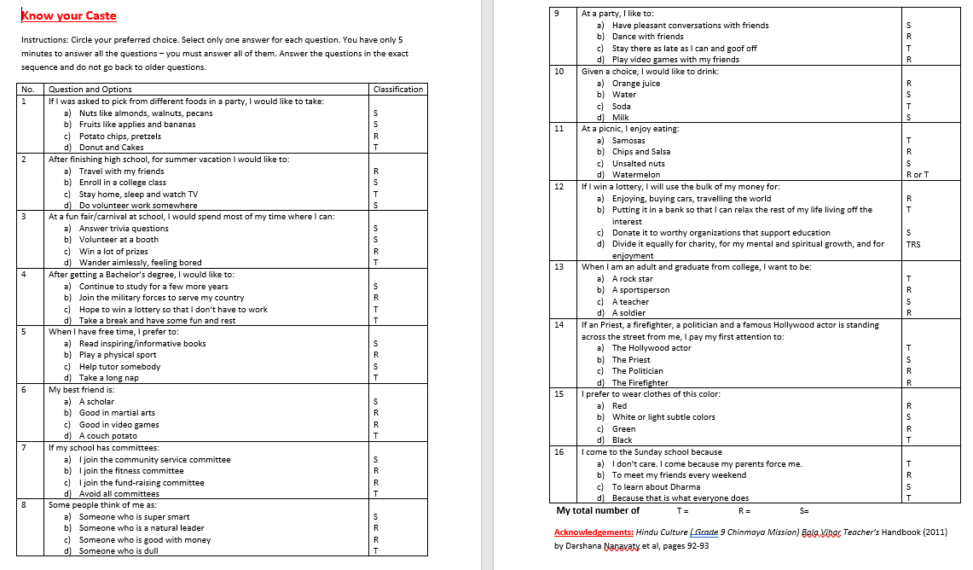

Slide 23
Our character determines Varna
The snake asked: There are four Varnas in this world – Brahmanas, Kshatriyas, Vaishyas and Shūdras. All the four of them accept the authority of the Vedas. If a Shūdra exhibits qualities of character such as truth, charity, forgiveness, refined behavior, ahimsa and compassion, then will he become a Brahmana? Mahabharata 3.177.18
Yudhishthira replied: If the expected characteristics are not seen in a Brahmana or in a Shūdra, then that Brahmana is not a Brahmana and that Shūdra is not a Shūdra. Mahabharata 3.177.20
But the Shūdra in whom these qualities (of a Brahmana) are present is a Brahmana, and in the Brahmana in whom the qualities of a Shūdra are present is a Shūdra indeed. Mahabharata 3.177.21

Slide 24
Examples of change of Varna
I am a reciter of hymns, my father is a doctor, my mother a grinder of corn. We desire to obtain wealth in various actions. Rigveda 9.112.3
O Indra, fond of Soma, would you make me the protector of people, or would you make me a ruler, or would you make me a Sage who has consumed Soma, or would you bestow infinite wealth to me? Rigveda 3.44.5

Slide 25
Hindu scriptures pray for all
Give luster to our Brahmanas, Give luster to our Kshatriyas.
Give luster to our Vaishyas and Shudras.
Through that luster, give luster to me.
Shukla Yajurveda (Mādhyandina Samhita) 18.48 = Krishna Yajurveda (Taittiriya Samhita) 5.7.6.3-4

Slide 26
Bhagavān speaks to everyone
Just as we have spoken beneficial words for the Brahmana and the Rulers, to the Shūdra and the Arya (Vaishya), to our kinsmen and to the strangers (so may you too speak beneficial speech to them). Shukla Yajurveda (Mādhyandina Samhita) 26.2
May I be beloved of the Brahmanas, the devas on this earth. May I be beloved of the Rulers (Kshatriyas). May I be beloved by all that see, of the Shūdras and the Āryas. Atharvaveda (Shaunaka Samhita) 19.62.1
In the Vedas, the word Ārya or Arya is sometimes used to denote the Vaishyas because it also means ‘cultivator’.

Slide 27
Bhagavan is present in All

Slide 28
Stories illustrating Varna Dharma in the Hindu Tradition

Slide 29
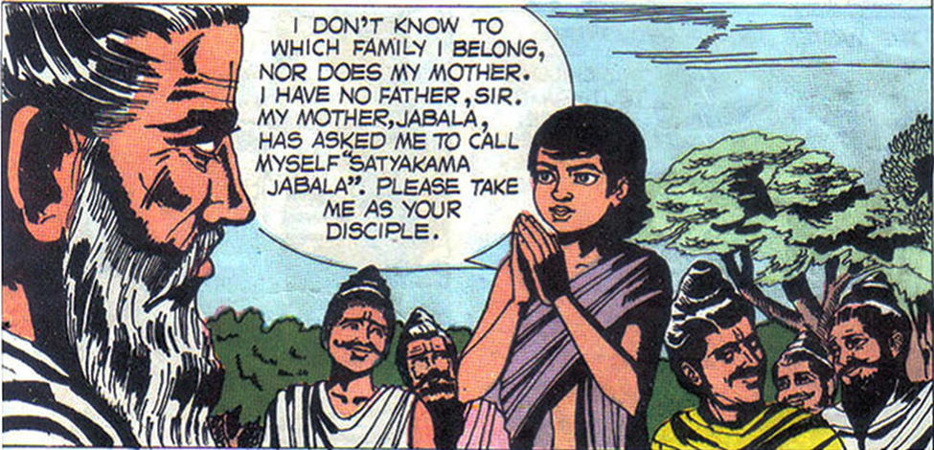
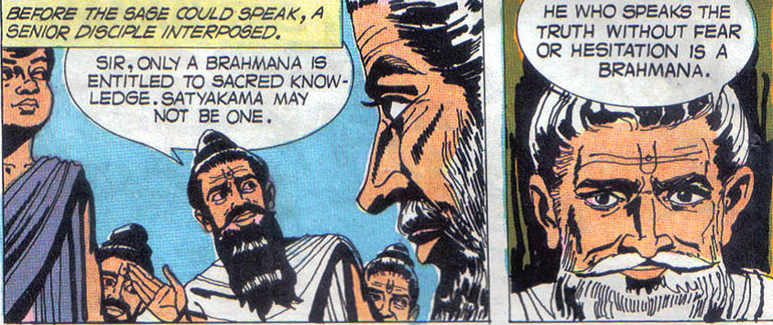
Story: Satyakāma becomes a Rishi
Notes:
The Story of Satyakāma Jabāla: Satyakāma, a boy born to a maid Jabālā once approached the renowned Rishi Gautama to teach him Jnāna. As was customer those days, the Rishi asked him details about his family. Satyakāma went home and asked his mother Jabālā about who his father was. She replied, “As a maid in my young age, I gave birth to you. I really do not know who your father is.”
Satyakāma did not want to hide this embarrassing truth about his parentage from the Rishi. He went back to Gautama and said, “My mother said that she served as a maid in her young age, and does not know who my father is. However, her name is Jabālā, and therefore I am Satyakāma Jabāla.
The other students in the school started laughing derisively because they all came from renowned families. They were proud of the fact that their parents were Brahmins. They thought and were sure that Rishi Gautama would not accept the illegitimate son of a maidservant as his student. But to their surprise, their Guru said, “Satyakāma did not forsake the truth, and spoke it fearlessly. None but a Brahmin speaks truth in this way. Bring the fire-sticks and other implements, for I will perform his sacred thread ceremony myself, and then he will become eligible formally to become my student.”
In the course of time, Jabāla became a great Rishi. Portions of the Vedas like the Jabāla Upanishad are named after him. This story shows that a good character, and not parentage are a pre-requisite for being imparted the knowledge about Moksha.

Slide 30
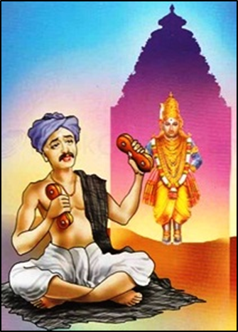
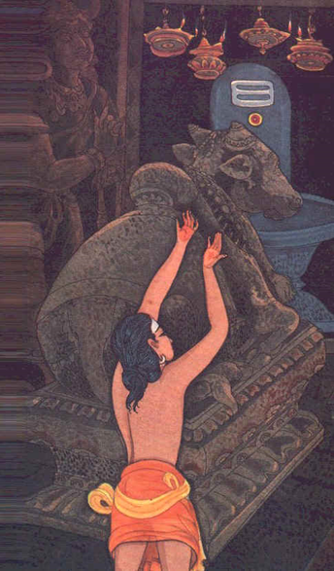
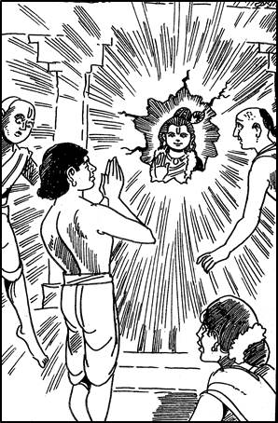
Bhagavān gives Darshan to all
Shiva asked Nandi to move away for Nandanar.
Sant Ravidas was a cobbler.
Sena was a barber.
Krishna Murti turned away from priests to give darshan to Kanakadasa.
Turtle murti in Srikurman temple rotated away from devotees.
The chin of Vitthala’s murti became swollen when the priest slapped the untouchable Chokhamela.

Slide 31
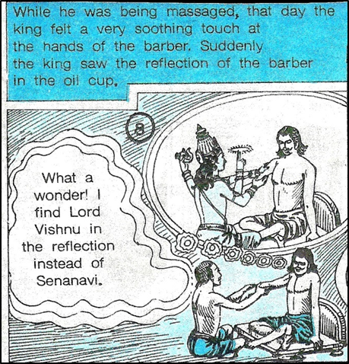
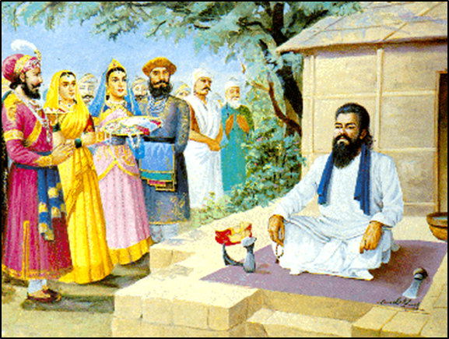
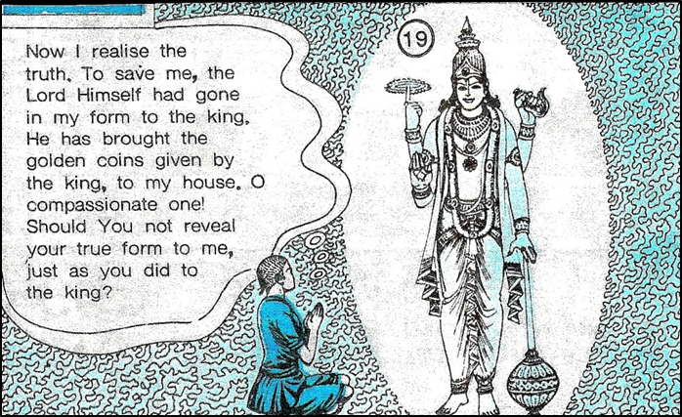
Many saints had a humble background
Sena was a barber
Ravidas was a cobbler

Slide 32
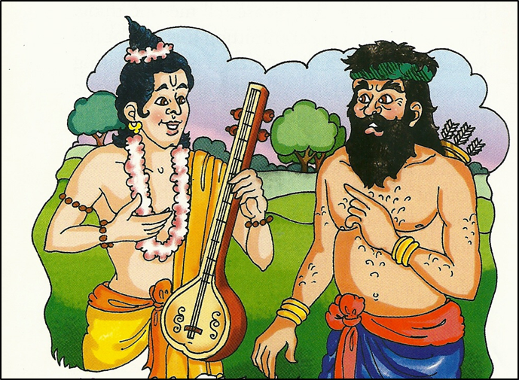
Many Rishis have a humble origin
Valmiki was a robber
Became a Rishi, wrote the Ramayana
Namadeva was a highway robber
Became a great saint

Slide 33
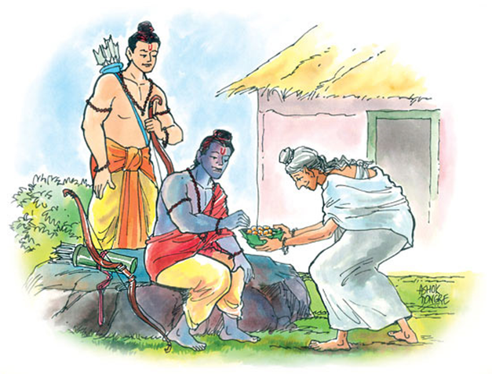
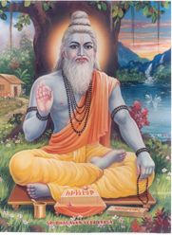
Many Rishis have a humble origin
Rishi Vashishtha was born to a dancer.
Rishi Vyasa was born to a fisherwoman
Narada was born to a dancer.
Kavasha Ailusha and Maharshi Aitareya were sons of maids.

Slide 34
Sant Ramanuja silences his upper caste students
“Knowledge, birth in a great family and wealth can make one arrogant. Dhanurdasa does not have any of these three types of arrogance. The Kaveri River’s water can only clean my external body. But the man’s heart and mind can only be cleaned by the touch of a person like Dhanurdasa, who has no arrogance of wealth, knowledge or birth in an elitist family.”

Slide 35
All humans are a spark of the Divine
During a sermon, Sant Narayan Guru saw two ‘untouchable’ boys seated behind the audience.
Narayan Guru asked them to come to the front and sit with him.

Slide 36
All humans are a spark of the Divine
Shankaracharya asked a chandāla to move out of his way.
The chandāla asked, “How can I remove the Lord who is in me and also in you?”
When the stunned saint looked at the chandāla, he had a darshana of Bhagavan Shiva.

Slide 37
Saints love all without prejudice
Sant Eknath’s love for all cures a leper: Eknath was outcasted for saving the life of a low caste baby. A leper had a dream in which Vithoba asked him to approach Eknath , whose pious act would cure him of his disease.
The Brahmanas realized that Eknath’s universal love made him a great sant in the Lord’s eyes.

Slide 38
Real pollutant is evil and dishonesty, not caste
Swamiji Dayanand Sarasvati said to his barber host, “There is nothing unclean about this roti. It is made of wheat, just as a roti from any other person. Only that food is unclean which is purchased with ill-gotten money, or which has contaminating stuff in it. I will definitely eat the roti offered by you.”

Slide 39
The ‘Cow, Caste, Curry’ Syndrome
Acknowledgement: Deepa Bhaskaran

Slide 40
Questions
Does Rama-Ravana war reflect caste conflict?
Was Ekalavya denied education in archery by Drona because the former was a tribal?
Is the Bhagavad Gita a ‘Brahmanical’ scripture?
Are Sanskrit and Vedas ‘Brahmanical’?
Is Hindu Dharma ‘Brahmanical’ though 95% Hindus are non Brahmanas?
Was Buddhism a ‘caste revolt’ against Brahmanical Hinduism?

Slide 41
My wedding and Caste: Times are changing….
My grandparents belonged to the same Varna (Vaishya), Jaati (Agrawal) and different Kula but from same region.
My parents belonged to the same Varna, Jaati and different Kula and different region (Delhi versus Punjab).
I and my wife belong to different Varnas (Vaishya, Kshatriya), different Jaatis (Agrawal, Khatri), different kulas and different regions (Delhi versus Punjab) and of course different Gotras (Goyal versus Bharadwaj)

Slide 42
Discrimination in Other Societies
Christianity – One Body in Christ?
Spread by enslavement of ‘Pagans’, and destruction of their religious heritage.
Indulged in Slave Trade, Colonialism and Imperialism.
Racism against Gypsies, Jews, African Americans etc. continues in the US and other Christian societies.
Racism against non-White Christians: Not a single non-White Pope in 2000 years; Indian nuns made to do menial tasks for White nuns in the West.
Each Christian sect considered others as heretical and destined for hell/slaughter
Islam – An Egalitarian Faith?
Arab Muslims considered superior to non-Arab Muslims; Sayyad Arabs considered superior to other Arabs. Exploitation of non-Arabs in the Middle East. Suppression of non-Arab communities (e.g. Berber Muslims) in N Africa.
Promoted slavery of and prejudices against Africans. Last countries to abolish slavery were Mauritania and Saudi Arabia in 1960s → both Islamic. Slavery is sanctioned by the Koran.
Large scale persecution of non-Muslims through Jihads, terrorism, temple destruction, Jizya taxes etc.
Non-Muslims are second class citizens in Islamic countries.
Shias and Sunnis consider each other inferior to themselves.

Slide 43
Inequality in Western Societies
Acknowledgement: Kalyan Vishwanathan

Slide 44
Income Inequality
Acknowledgement: Kalyan Vishwanathan

Slide 45
Social Heirarchy

Slide 46
Home Ownership by Race in the US
Acknowledgement: Rakesh Bahadur

Slide 47
Modern Times and Applicability of Varna-Jāti Systems
The basic idea that for the stability of the society, all the four sectors (religious/sacerdotal; military/political; economic; service) must exist is correct.
However, birth-based eligibility of individuals for acquiring specific skills is not fair.
Modern systems of education can accelerate learning. E.g. a person born in a priest’s family can become a soldier.
Every individual must specialize in one area, but develop sufficient expertise in all the other sectors to be well-rounded.
Certain hierarchical notions of the Varna system might be more balanced. Society must respect those devoted to religious and spiritual pursuits instead of idolizing rock stars.
Ban on marrying within one’s own ‘gotra’ or ‘pinda’ reduces the probability of genetic defects (congenital diseases).
People with more abilities do have more rights, and greater duties and privileges; and vice versa.
Hinduism is derided as ‘Brahmanism’ and ‘Anti-Brahmanism’ is prevalent.

Slide 48
Caste System: Take Home Message
The word ‘caste’ includes three different systems” Four Social Classes (varna), hereditary community lineage (jaati), and family descent (kula/gotra).
Initially, the varna system was based on character (guna, svabhaava) and profession (division of labor), but later it became hereditary and discriminatory. This is when the problems started.
Hindu scriptures, traditions and sants have fought against social discrimination. Many of our greatest Rishis and sants had humble origins and they wrote many of our important scriptures.
Hindu societies have today made caste based discrimination illegal and ‘low’ castes are catching up with ‘high’ castes, but much more needs to be done.
All societies have ‘divinely’ sanctioned social injustices and inequalities, and they persist to this day. Hindus were free of evils like racism and slavery. Untouchability has no basis in Hindu scriptures.
Historically, there were advantages as well as disadvantages of the varna system.
But today, the varna and jaati system are not very relevant and have no real benefits, but exogamy based on gotra differences must be encouraged. We must have the skills of all castes even when focussing on one particular profession to succeed in life.

